Slide 1
Portfolio Construction based on advanced econometric models and machine learning techniques
M.Sc. In Data Science
Supervisor: Ioannis Vrontos
Author: Panagiotis Zioulis

Slide 2
Risk
Uncertainty
Decisions
Tolerance
Profit

Slide 3
Systematic Risk: caused by macroeconomic factors
Unsystematic Risk: caused by the actions of a business or an investor
Solution: Portfolio Construction
Portfolio is a combination of securities
Fundamental principal: Diversification

Slide 4
Modern Portfolio Theory
Mean-Variance
Minimum Variance
Portfolio with minimum variance
Constraints:
Nonnegative weights
Sum weights are 1
Expected return at least equal to a target return
Task: Trade-off between risk and return
Portfolio with minimum variance
Constraints:
Sum weights are 1
Nonnegative weights
Task: Risk reduction

Slide 5
Performance Measurements
Treynor Ratio:
Focus on systematic risk
Easy to calculate and interpret
Sharpe Ratio:
Standard deviation
Easy to calculate and interpret
Jensen’s Alpha:
Evaluates manager’s skill
Positive constant$⇒$ superior in his/her investment ability
Negative constant $⇒$ inferior in his/her investment ability

Slide 6
Why Machine Learning?
Handling Non-Linear relationship
Process and analyze big data
Anomaly Detection
Model Adaption and Learning Over Time

Slide 7
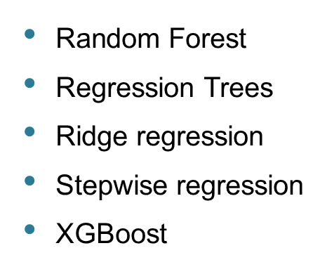
Knowing our data and techniques
215 return of funds from 31/07/1963 to 31/07/2019
6 factors: Mkt-RF, SMB, HML, RMW, CMA and MOM
Out-of-sample: last 36 months and target return: 0.007
Techniques:
Elastic Net
LASSO regression
Best subset regression with adjusted $R^{2}$ and BIC
Multiple regression - GARCH type models
Neural Network
Quantile regression

Slide 8
Technique | Mean Return | Volatility | Cumulative Return Conditional | Sharpe Ratio
Jensen’s Alpha | 0.007353374 | 0.03683723 | 0.2647215 | 0.1996180
Treynor | 0.008007133 | 0.03641633 | 0.2882568 | 0.2198776
XGBoost | 0.008641310 | 0.03593746 | 0.3110872 | 0.2404541
Sharpe | 0.008816205 | 0.03657588 | 0.3173834 | 0.2410388
Quantile regression | 0.009314386 | 0.03658249 | 0.3353179 | 0.2546132
Multiple regression –GARCH type models | 0.010083597 | 0.03761706 | 0.3630095 | 0.2680591
Leaps regression with adjusted $R^{2}$ | 0.010485302 | 0.03738625 | 0.3774709 | 0.2804588
Stepwise regression | 0.010708827 | 0.03750527 | 0.3855178 | 0.2855286
Leaps regression with BIC | 0.010762177 | 0.03745968 | 0.3874384 | 0.2873003
Ridge regression | 0.010794749 | 0.03805739 | 0.3886110 | 0.2836440
Elastic Net | 0.010812245 | 0.03800482 | 0.3892408 | 0.2844967
Neural Network | 0.010853384 | 0.03944682 | 0.3907218 | 0.2751396
LASSO regression | 0.010911990 | 0.03767896 | 0.3928316 | 0.2896043
Random Forest | 0.011445474 | 0.04037162 | 0.4120371 | 0.2835029
Regression Trees | 0.012057963 | 0.03964236 | 0.4340867 | 0.3041687

Slide 10
XGBoost
Method | Portfolio | Mean Return | Volatility | Cumulative Return Conditional | Sharpe Ratio
Simple Mean and Covariance Estimation | Minimum Variance | 0.0082 | 0.0292 | 0.2944 | 0.2750
 | Mean Variance | 0.0081 | 0.0292 | 0.2905 | 0.2704
Single Index Model | Minimum Variance | 0.0082 | 0.0305 | 0.2944 | 0.2683
 | Mean Variance | 0.0082 | 0.0305 | 0.2944 | 0.2683
Multiple Factors | Minimum Variance | 0.0082 | 0.0305 | 0.2944 | 0.2683
 | Mean Variance | 0.0082 | 0.0305 | 0.2944 | 0.2683
Constant Conditional Correlation | Minimum Variance | 0.014 | 0.0406 | 0.5048 | 0.3451
 | Mean Variance | 0.014 | 0.0406 | 0.5048 | 0.3451

Slide 11
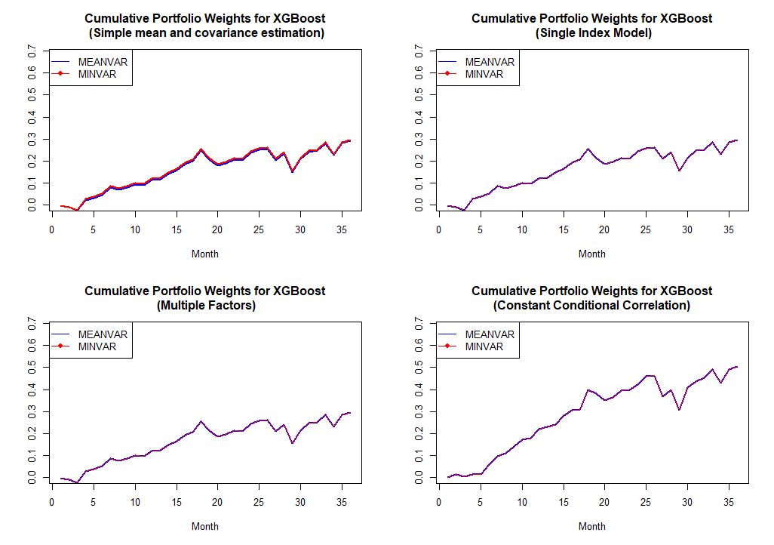

Slide 12
Multiple regression – GARCH type models
Method | Portfolio | Mean Return | Volatility | Cumulative Return Conditional | Sharpe Ratio
Simple Mean and Covariance Estimation | Minimum Variance | 0.0077 | 0.0234 | 0.2777 | 0.3094
 | Mean Variance | 0.0082 | 0.0243 | 0.2963 | 0.3078
Single Index Model | Minimum Variance | 0.008 | 0.0263 | 0.2883 | 0.305
 | Mean Variance | 0.008 | 0.0263 | 0.2883 | 0.305
Multiple Factors | Minimum Variance | 0.0077 | 0.0262 | 0.277 | 0.2937
 | Mean Variance | 0.0077 | 0.0262 | 0.277 | 0.2937
Constant Conditional Correlation | Minimum Variance | 0.0168 | 0.0447 | 0.6055 | 0.376
 | Mean Variance | 0.0168 | 0.0447 | 0.6055 | 0.376

Slide 14
Random Forest
Method | Portfolio | Mean Return | Volatility | Cumulative Return Conditional | Sharpe Ratio
Simple Mean and Covariance Estimation | Minimum Variance | 0.0121 | 0.0382 | 0.4350 | 0.3154
 | Mean Variance | 0.0124 | 0.0416 | 0.4478 | 0.2834
Single Index Model | Minimum Variance | 0.0117 | 0.0387 | 0.4228 | 0.3036
 | Mean Variance | 0.0124 | 0.0396 | 0.4474 | 0.3140
Multiple Factors | Minimum Variance | 0.0115 | 0.0385 | 0.4148 | 0.2989
 | Mean Variance | 0.0124 | 0.0397 | 0.4474 | 0.3129
Constant Conditional Correlation | Minimum Variance | 0.0126 | 0.0402 | 0.4524 | 0.3125
 | Mean Variance | 0.0126 | 0.0402 | 0.4524 | 0.3125

Slide 15
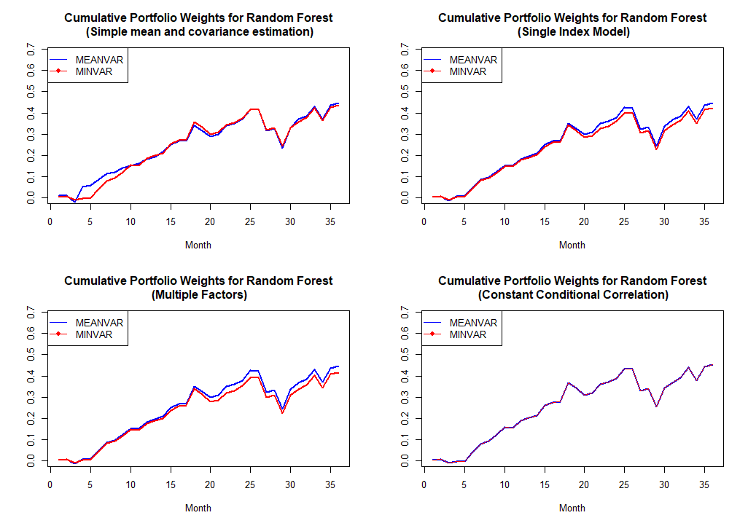

Slide 16
Regression Trees
Method | Portfolio | Mean Return | Volatility | Cumulative Return Conditional | Sharpe Ratio
Simple Mean and Covariance Estimation | Minimum Variance | 0.0119 | 0.0383 | 0.4295 | 0.3104
 | Mean Variance | 0.0131 | 0.0429 | 0.4729 | 0.2896
Single Index Model | Minimum Variance | 0.0117 | 0.0388 | 0.4214 | 0.3015
 | Mean Variance | 0.0128 | 0.0398 | 0.4620 | 0.3226
Multiple Factors | Minimum Variance | 0.0114 | 0.0387 | 0.4117 | 0.2957
 | Mean Variance | 0.0128 | 0.0398 | 0.4620 | 0.3222
Constant Conditional Correlation | Minimum Variance | 0.0146 | 0.0865 | 0.5267 | 0.1691
 | Mean Variance | 0.0146 | 0.0865 | 0.5267 | 0.1691

Slide 17
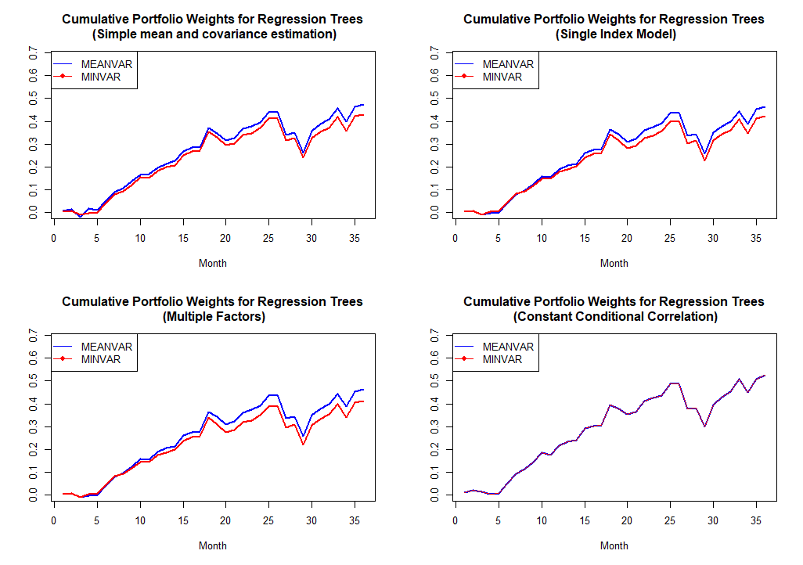

Slide 18
Constant Conditional Correlation for Mean/ Minimum Variance Portfolios
Technique | Mean Return | Volatility | Cumulative Return Conditional | Sharpe Ratio
Elastic Net | 0.0172 | 0.0718 | 0.6205 | 0.24
LASSO regression | 0.0172 | 0.0718 | 0.6205 | 0.24
Ridge regression | 0.0146 | 0.0758 | 0.573 | 0.1931
Neural Network | 0.0155 | 0.054 | 0.5564 | 0.2861
Quantile regression | 0.0128 | 0.0466 | 0.4611 | 0.2751
Stepwise regression | 0.0146 | 0.0758 | 0.5273 | 0.1931
Best subset regression with adjusted $R^{2}$ | 0.0172 | 0.0718 | 0.6205 | 0.24
Best subset regression with BIC | 0.0172 | 0.0718 | 0.6205 | 0.24

Slide 19
Conclusion
Multiple regression- GARCH type models $⇒$ Cumulative Return:+66% & Sharpe Ratio:+40%
Random Forest $⇒$ Cumulative Return:+10% & Sharpe Ratio:+10%
XGBoost $⇒$ Cumulative Return:+63% & Sharpe Ratio:+43%
Regression Trees $⇒$ Cumulative Return:+7% & Sharpe Ratio:+6%
Increase in Cumulative Return but not in Sharpe Ratio for the rest techniques

Slide 20
THANK YOU
Do you have any questions or comments?

